Slide 1

End-to-end deep learning
Whether to use
end-to-end learning
deeplearning.ai

Slide 2
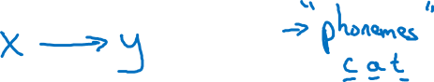
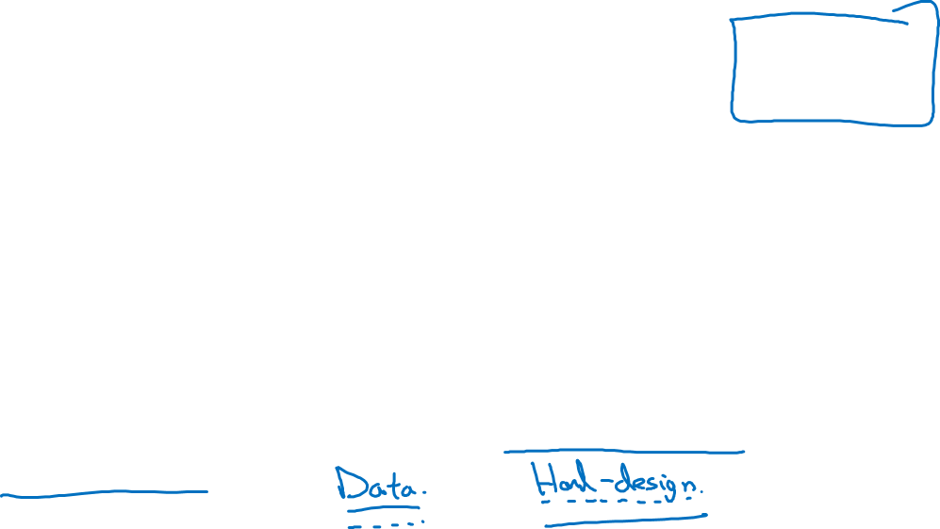
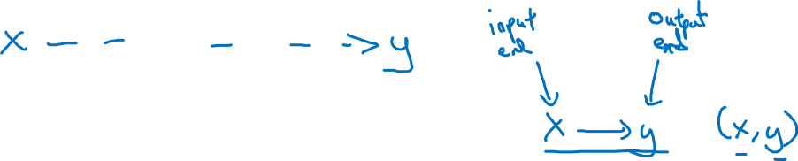
Pros and cons of end-to-end deep learning
Pros:
Let the data speak
Less hand-designing of components needed
Cons:
May need large amount of data
Excludes potentially useful hand-designed components

Slide 3
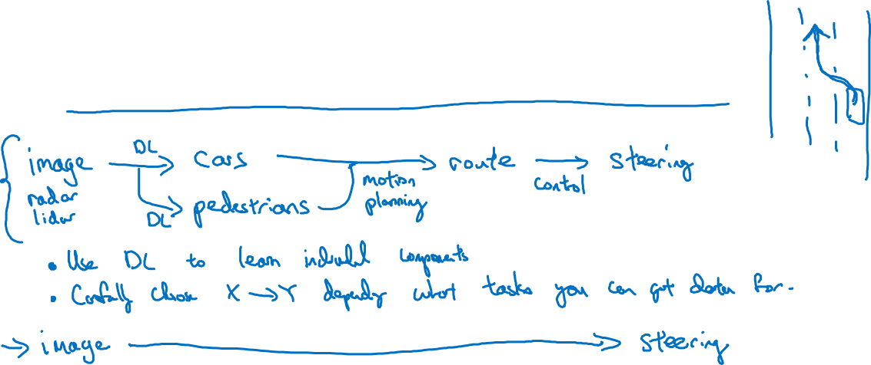
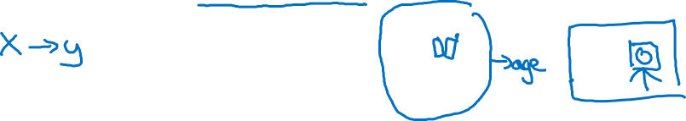
Applying end-to-end deep learning
Key question: Do you have sufficient data to learn
a function of the complexity needed to map x to y?

